Slide 1
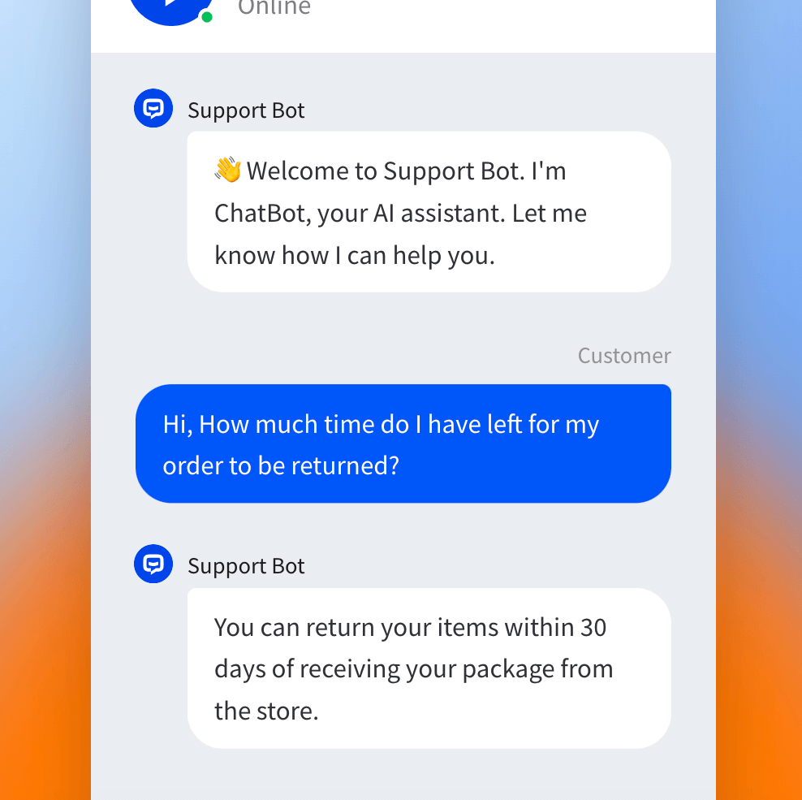
AUTOMATING
CUSTOMER
SUPPORT
PROCESS
TEAM - CODE DIVAS
MEMBERS –
KARTIKEY VATS
JITESH KUMAR
PAWAN

Slide 2
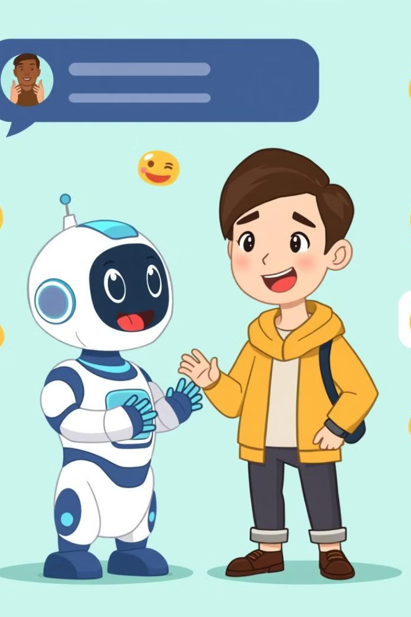
Customer Support Chatbot: Elevating Customer Experience
Welcome to the future of customer support, where technology seamlessly blends with human-like interaction. Our customer support chatbot is meticulously designed to provide a personalized, efficient, and comprehensive experience for every user. Imagine a virtual assistant that can understand your needs, respond in multiple languages, and even offer a choice of voice responses from beloved local celebrities.

Slide 3
FUTURE OF CUSTOMER SERVICE CHATBOT
Increased AI Integration
Chatbots will become more autonomous.
Capable of handling complex interactions.
Integration with AI technologies like machine learning and predictive analytics.
24/7 Availability
AI chatbots provide uninterrupted service 24/7.
Meet growing customer demands for instant support.
Enhances customer retention and satisfaction.

Slide 4
Emotional Intelligence
Advanced chatbots will detect customer emotions.
Respond more empathetically and in a human-like manner.
Improved customer satisfaction through emotionally aware interactions
Voice-Activated Bots
Increased use of voice search and smart speakers.
Voice-activated customer service chatbots on platforms like Amazon Alexa and Google Assistant.
Enhanced accessibility for customers preferring voice interactions.

Slide 5
IMPACT OF CHATBOTS ON CUSTOMER LIFE
Enhanced Convenience
On-Demand Support: Chatbots provide round-the-clock availability, allowing
customers to resolve issues anytime without waiting for a human agent.
Self-Service Options: By automating frequently asked questions (FAQs)
and routine queries, customers can quickly find answers and solutions.
Statistical Insight: According to Gartner, by 2027, 25% of companies are
expected to integrate self-service chatbots across customer journeys, reducing customer effort.
Faster Response Time
Instant Answers: Chatbots can respond within milliseconds,
reducing the average wait time for customers significantly.
Real-Time Problem-Solving: For simple issues, bots can provide immediate solutions,
avoiding the delays often associated with human agents.
Statistical Insight: A study by Juniper Research estimates that chatbots can save companies over $11 billion per year in customer service costs by speeding up response times.

Slide 6
Greater Accessibility
Voice-Activated Assistance: For customers who have difficulty navigating complex menus or interfaces, voice-activated bots offer a user-friendly solution.
Statistical Insight: The World Health Organization estimates that 1 billion people worldwide
live with disabilities, highlighting the need for accessible customer service solutions.
Trust and Reliability
Improved Accuracy: As chatbots leverage advanced AI and machine learning algorithms,
their responses become more accurate, reducing misunderstandings or incorrect answers.
Statistical Insight: A study by Oracle suggests that 80% of businesses plan to use chatbots
for customer interactions by 2025, reinforcing the reliability and trustworthiness of automated systems.

Slide 7
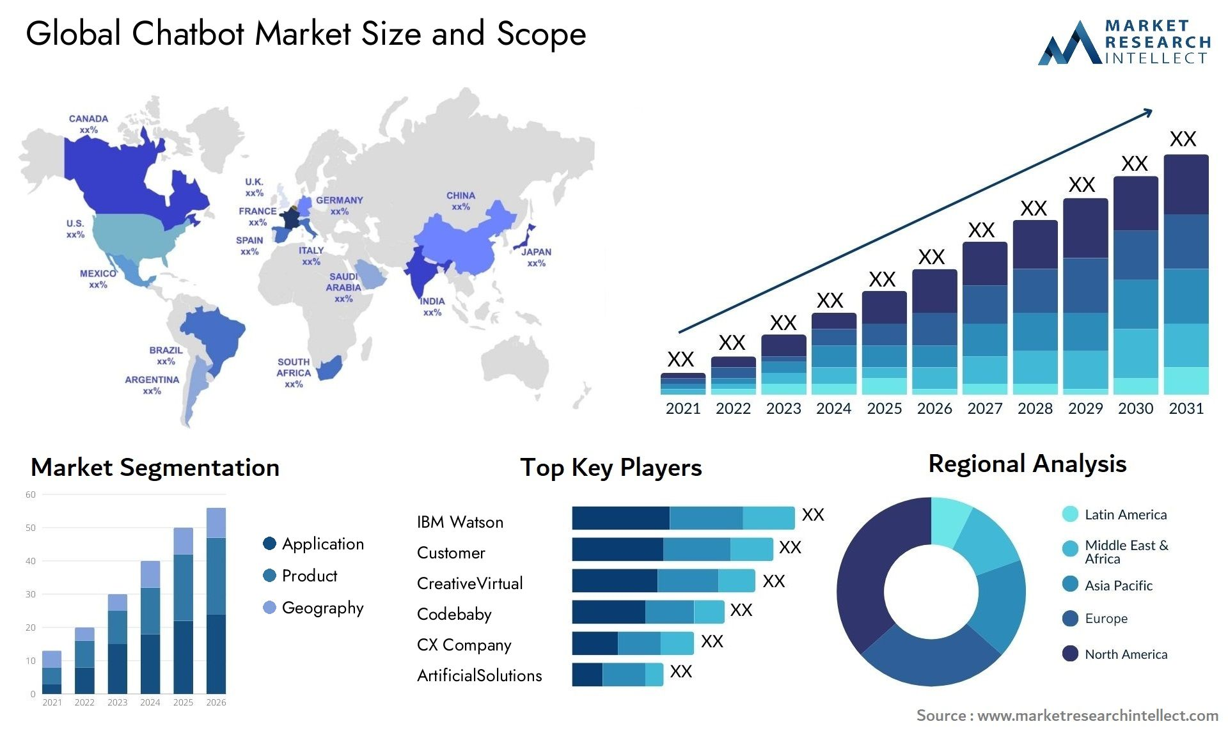
GLOBAL MARKET DEMAND OF CHATBOTS

Slide 8
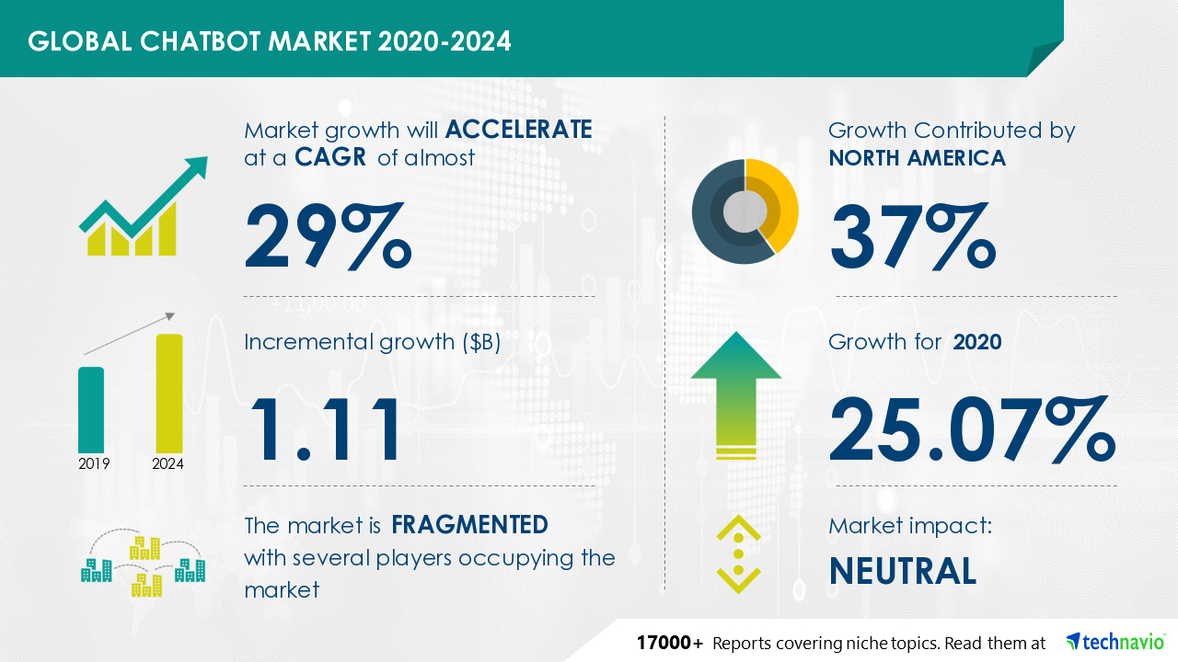

Slide 9
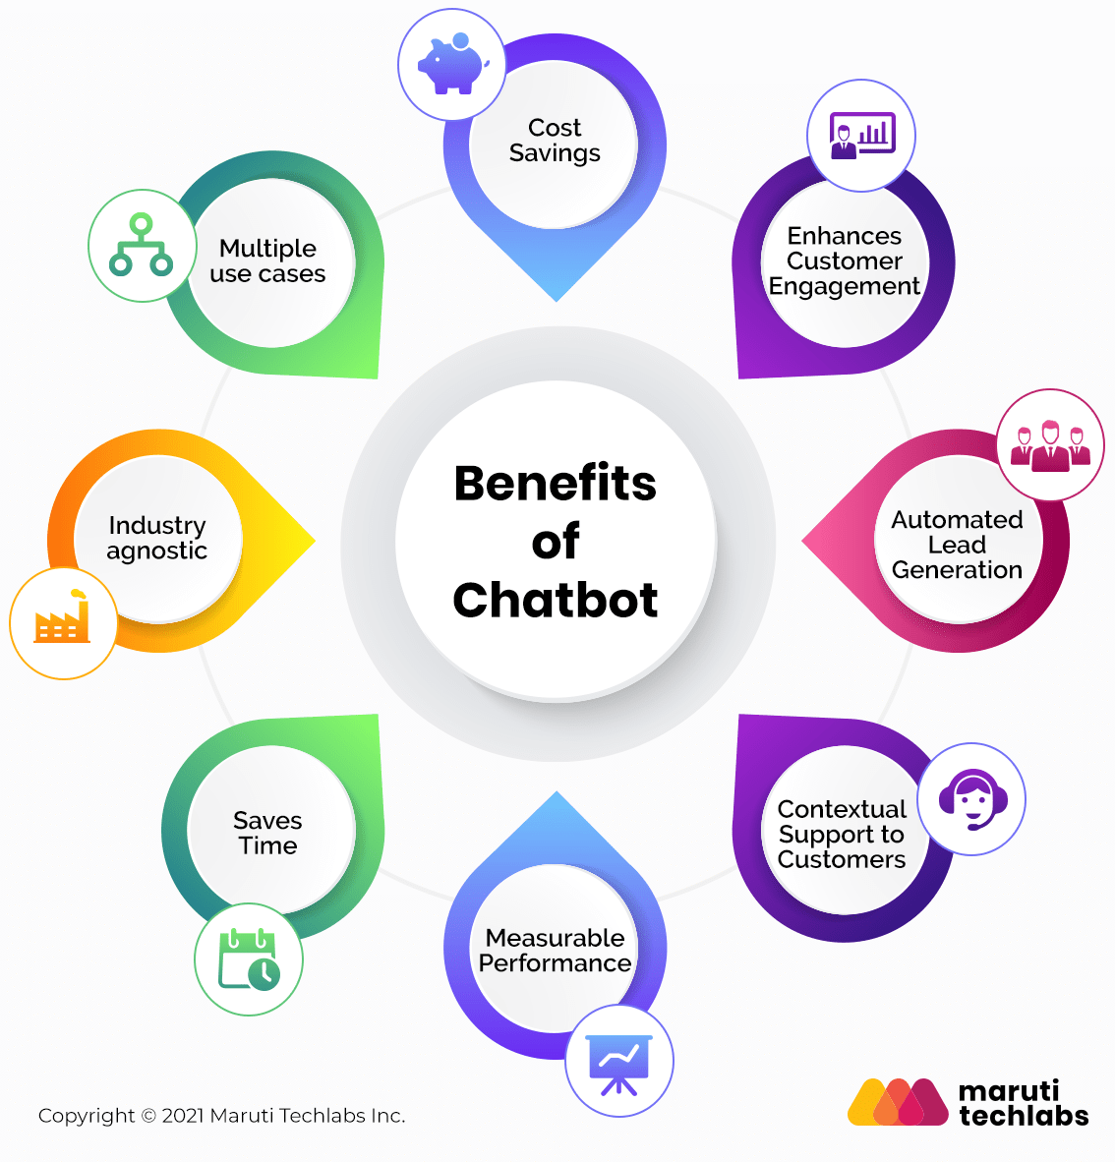
FEATURES
AI-Based Artist Selection and Voice Synthesis
Seller Complaint Tracking and Reporting
MULTILINGUAL SUPPORT
Text and Voice Response Options
Chat Export Features
Escalation to Live Executive

Slide 10
AI-Based Artist Selection and Voice Synthesis
Artist Selection by AI
The AI is trained to identify the region and time period based on user queries.
It selects an appropriate artist.
Converts AI's response into speech using voice samples of the selected artist.
Voice Synthesis Technology
Uses text-to-speech APIs (e.g., Google Cloud Text-to-Speech or Amazon Polly).
Tacotron 2 (by Google) + WaveGlow or WaveNet (for audio waveform generation).
VALL-E (by Microsoft), a more advanced voice synthesis model.
INTEGRATING TECHNOLOGY
Dialogflow (by Google)
Rasa (an open-source AI chatbot framework)
Microsoft Bot Framework
Amazon Lex (for Alexa skills and customer service automation
IMPACT ON CUSTOMER
Familiarity and Trust Brand Association: Using the voice of a trusted figure could make the interaction feel more personalized and authoritative.
Entertainment Value:. Customers may appreciate the novelty of speaking to a recognizable voice, which could keep them more engaged during the support process.

Slide 11

Seller Complaint Tracking and Reporting
Complaint Tracking
The chatbot meticulously records all complaints against sellers, ensuring that every issue is documented and reviewed for further action.
The system automatically generates comprehensive reports on seller complaints, providing valuable insights into common issues and allowing the company to address concerns proactively.
Reporting
Email Notifications
Regular email notifications are sent to relevant stakeholders, keeping them informed about complaint trends and enabling them to make timely decisions to improve seller performance and customer satisfaction.
Optimized Workforce: Data-driven insights help allocate resources efficiently, improving productivity and response times.
Informed Decision-Making: Tracking complaints provides actionable insights to address recurring issues and improve products or services.

Slide 12
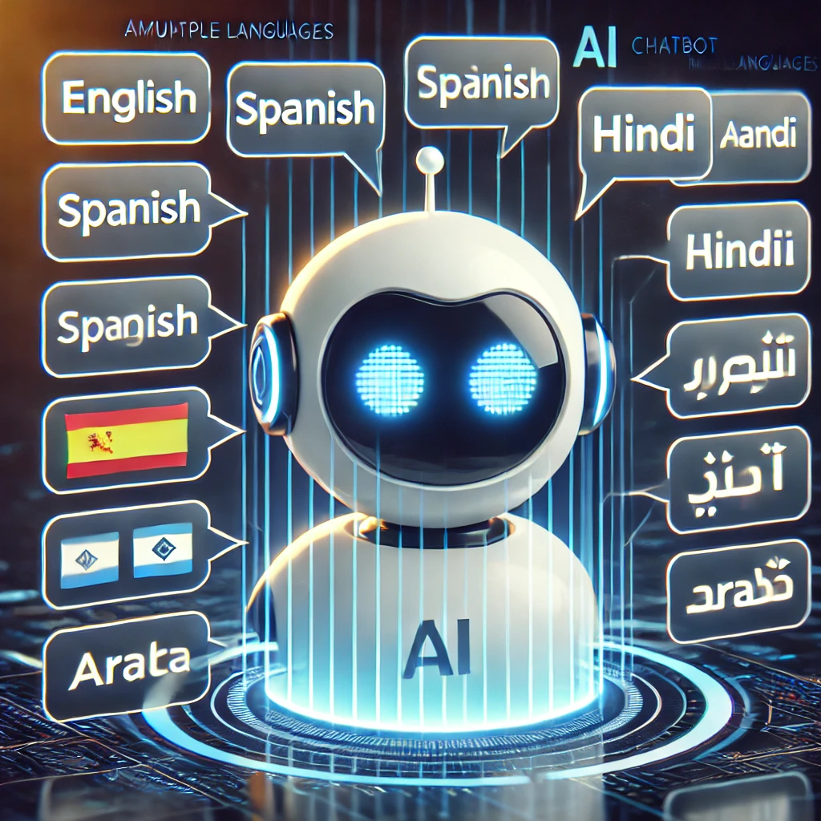
Support for Multiple Languages
1
Global Reach
2
Multilingual Capabilities
chatbot supports multiple languages, making it accessible to a wider audience and breaking down language barriers.
The chatbot utilizes advanced language translation technology to seamlessly translate between languages, enabling users to communicate and receive information in their preferred language.
3
Accurate Translations
4
Technologies Used
Our team of language experts continuously refine the chatbot's language models to ensure accurate and natural-sounding translations, delivering a smooth and enjoyable user experience.
Google Translate API
Microsoft Translator API
Helps the chatbot recognize text
or speech and respond
Appropriately.

Slide 13
Text and Voice Response Options
Text-Based Communication
Voice-Enabled Responses
The chatbot can provide clear and concise text-based responses, effectively answering your questions and addressing your concerns. This mode of communication is ideal for users who prefer to read or simply find it easier to comprehend information in a written format.
Beyond text, the chatbot can also deliver its responses through voice. This feature allows users to hear the answers, making the interaction more engaging and natural, especially for those who enjoy a more auditory experience.

Slide 14

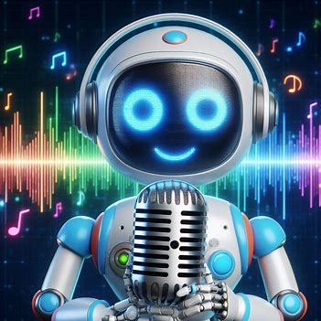
Voice Recognition Capabilities
1
Natural Language Processing
The chatbot utilizes advanced natural language processing (NLP) techniques to understand your questions and requests, even if they are phrased in a casual or conversational manner. This ensures a natural and intuitive interaction, much like talking to a real person.
2
Speech Recognition
Our chatbot is equipped with state-of-the-art speech recognition technology, allowing you to communicate through voice commands, making it incredibly user-friendly, especially for users who prefer vocal interaction or have difficulty typing.
3
Voice Customization
For an even more engaging experience, users can choose from a library of voice options, including those of local celebrities. This personal touch adds a layer of entertainment and makes the interaction feel less robotic and more human.

Slide 15

Chat Export Features
TECHNOLOGY USED
Preserving Information
PDF Format
Javascript
Download the
Conversation
In pdf or text format.
ensure that users can easily preserve their conversations, useful for future reference or for resolving any potential issues.
Gives sense of Security to the Customer
Plain Text Format

Slide 16





Escalation to Live Executive
Intelligent Routing
If the chatbot is unable to resolve a user's issue, it automatically escalates the request to a live executive, ensuring that every customer receives the assistance they need.
Expert Assistance
Our team of experienced executives is readily available to provide personalized and expert support, resolving complex issues and offering tailored solutions to meet individual customer needs.
Seamless Transition
The transition from the chatbot to a live executive is seamless, ensuring a smooth and efficient flow of communication, minimizing wait times and providing a consistent level of support throughout the process.

Slide 17




Priority Queue for Paid Members
Exclusive Benefits
Paid members enjoy priority access to live executive support, ensuring their inquiries are addressed promptly and efficiently. This exclusive benefit provides an added layer of value to their membership.
Reduced Wait Times
Paid members experience significantly reduced wait times when connecting with live executives, ensuring that their issues are resolved quickly and without undue delays.
Enhanced Customer Care
This priority service demonstrates the company's commitment to providing exceptional customer care to its valued paid members, solidifying loyalty and fostering a positive relationship.

